Slide 1
State Matura Exam Processing System
Ivan Budišćak, M.Sc.
Prof. Vedran Mornar, PhD
Prof. Damir Kalpić, PhD
Fran Tonković, M.Sc.
Danijel Mlinarić, M.Sc.
Tomislav Rajnović, M.Sc.
University of Zagreb, Faculty of Electrical Engineering and Computing, Department of Applied Computing

Slide 2
Outline
Overview
Legislation
The structure of the exam
Delivery of exams to schools
Conducting exams in schools
Return of exams to NCEEE
Assessment of exams in NCEEE
Processing exam results
Implementation
Conclusion
University of Zagreb, Faculty of Electrical Engineering and Computing, Department of Applied Computing

Slide 3
Overview (1)
Conducted by the National Centre for External Evaluation of Education (NCEEE)
28 (24) subjects
Mandatory exams (prerequisite for applications to universities)
Croatian language
Mathematics
Foreign language
Elective exams
National minority native language exams – for students that attend classes held on national minority language
9 subjects with two levels - A and B (easier)
Two terms - summer and autumn
University of Zagreb, Faculty of Electrical Engineering and Computing, Department of Applied Computing

Slide 4
Overview (2)
Summer term
35,000 to 40,000 participants
More than 160,000 applications
More than 200,000 exams – some exams have two parts
Autumn term
Around 10% of students apply for exams in autumn term
Certificates
Gymnasium
Vocational schools
Foreign participants
Students graduated from high school before school year 2009/2010
Multiple admission to exams
University of Zagreb, Faculty of Electrical Engineering and Computing, Department of Applied Computing

Slide 5
Legislation
National Centre for External Evaluation of Education Act
Regulates the activity, structure and other matters of importance for the performance of activities of the NCEEE
Ordinance on the taking of state matura exams
Prescribes the content, conditions, manner and procedure of taking the state matura and the state matura exam
Information Security Act
Classified Information Act
Personal Data Protection Act
University of Zagreb, Faculty of Electrical Engineering and Computing, Department of Applied Computing
Notes:
Zakon o Nacionalnom centru za vanjsko vrednovanje obrazovanja
Pravilnk o polaganju državne mature
Zakon o informacijskoj sigurnosti
Zakon o tajnosti podataka
Zakon o zaštiti osobnih podataka

Slide 6
The structure of the exam
Exam items
Questions booklet (up to 40 pages)
Form for students’/reviewer answers
Concept booklet
Exams are modified for students with special needs (large font, Braille…)
Multiple exam versions for each subject
4 versions each year – one is used
Each version has different questions
Number of questions and/or structure can vary for each version
Future work (NCEEE plans)
Standardization of exam structure
Questions data bank
University of Zagreb, Faculty of Electrical Engineering and Computing, Department of Applied Computing

Slide 7
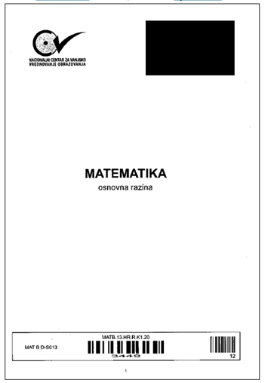
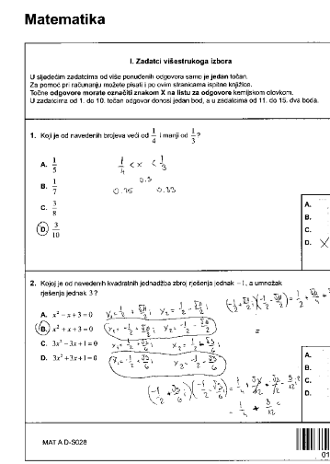
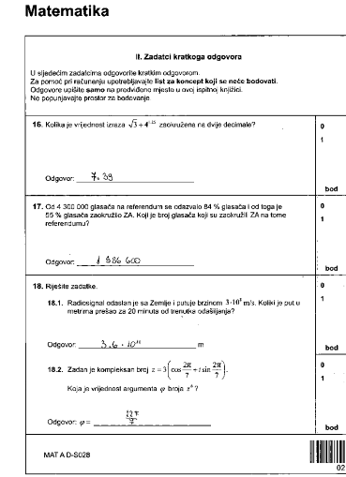
Questions booklet
University of Zagreb, Faculty of Electrical Engineering and Computing, Department of Applied Computing

Slide 8
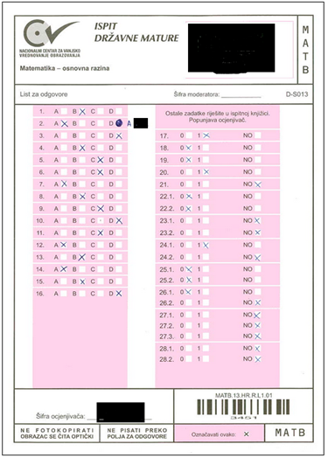
Form for students’/reviewer answers
University of Zagreb, Faculty of Electrical Engineering and Computing, Department of Applied Computing

Slide 9
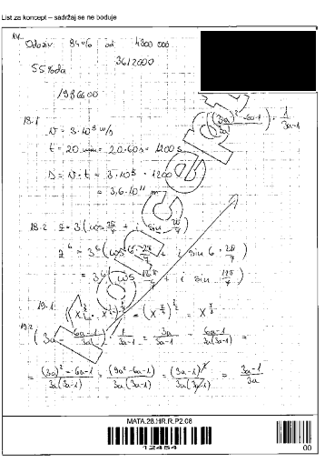
Concept booklet
University of Zagreb, Faculty of Electrical Engineering and Computing, Department of Applied Computing

Slide 10
Delivery of exams to schools
Challenges for NCEEE and schools’ staff
Delivery of exams on time (islands) to more than 350 high schools
Ensure safe storage of exams in schools
Personalized exams
Exam package is marked with a student’s name, last name and code (manually)
Registering exams in the system (at the NCEEE / schools)
Exam category
Normal exam / Spare exam
Exam adopted for student with special needs
Exam translated to a national minority native language
Exam number (scanned with barcode scanner)
Student’s code (scanned with barcode scanner)
University of Zagreb, Faculty of Electrical Engineering and Computing, Department of Applied Computing

Slide 11
Conducting exams in schools
Exam starts at the same time in all schools
Supervision
Teachers supervising students
NCEEE, Ministry and state administration staff supervising teachers
Allocation of students in rooms
Generated by the system
Each student has a dedicated seat in the room
Exam record – for each student
When he/she started the exam
When he/she finished the exam
Interruptions (going to the toilet)
University of Zagreb, Faculty of Electrical Engineering and Computing, Department of Applied Computing

Slide 12
Return of exams to NCEEE
Challenges
Delivery of exams on time (islands) back to NCEEE (short deadlines)
Storage of the exams in NCEEE for further processing – misplaced exams
Registering exams in the system (at the schools / NCEEE)
Exam category
Used/unused exam
Used/unused spare exam
Damaged exam
Excess exam (exam was sent to school but the student did not satisfy the conditions for taking the exam)
Exam adapted for student with special needs
Exam translated to a national minority native language
Exam number
Student’s code
University of Zagreb, Faculty of Electrical Engineering and Computing, Department of Applied Computing

Slide 13
Assessment of exams in NCEEE
External evaluation
More than 1000 high school teachers from all over the country participate in the assessment of state matura exams
Moderators supervise the assessment
Each exam item is registered in the system
Before and after assessment (protection from misplaced exam items)
Reviewer’s code
Exam item code
Multiple assessment
Essay tasks are assessed two times
Third (final) assessment - if the difference between first two assessments is >= 20%
10% of Croatian language exams are assessed three times
University of Zagreb, Faculty of Electrical Engineering and Computing, Department of Applied Computing

Slide 14
Processing exam results (1)
Scanning of exam items
Questions booklet, concept booklet and form for students’/reviewer answers
More than 5,000,000 images (~100 GB)
Questions booklet – GIF (low quality)
Form for students’/reviewer answers – JPEG (high quality)
OCR
Form(s) for students’/reviewer answers
More than 10,000,000 records (one record for each answer)
Output is a percentage of form field filling
Processing OCR results
Detection of multiple selections
Detection of students’ errors corrections
University of Zagreb, Faculty of Electrical Engineering and Computing, Department of Applied Computing

Slide 15
Processing exam results (2)
Exam results are presented through web application
HTML is generated up front for summary results and detailed results for each exam
Exam images are stored on file system (hash)
Folder for each term
Folder for each exam item
100 images in one file
University of Zagreb, Faculty of Electrical Engineering and Computing, Department of Applied Computing

Slide 16
Summary results for a student
University of Zagreb, Faculty of Electrical Engineering and Computing, Department of Applied Computing

Slide 17
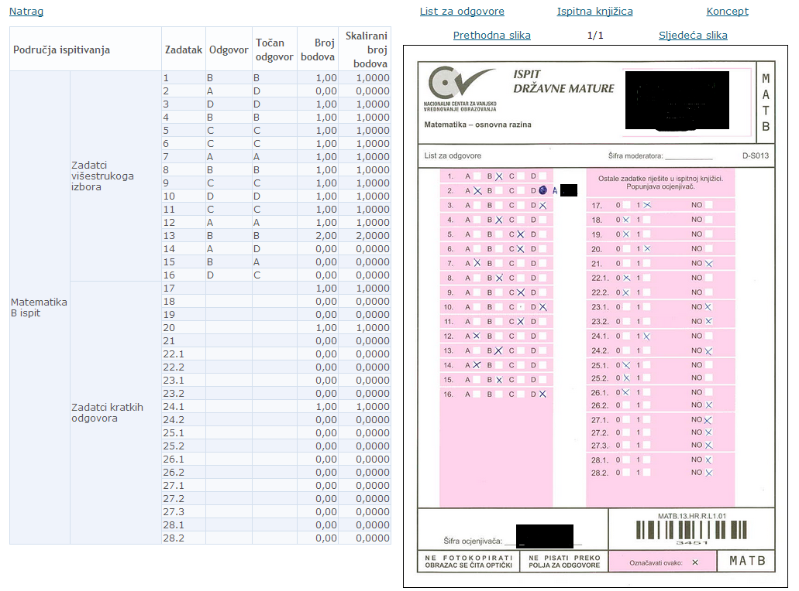
Detailed results for the exam
University of Zagreb, Faculty of Electrical Engineering and Computing, Department of Applied Computing

Slide 18
Implementation
State Matura Central Register
Part of National Information System for Application to Higher Education Institutions (NISAHEI)
~ 250 database tables
~ 700 stored procedures
~ 250 forms for data input
~ 200 reports
Generic approach
6 months of development
GenLib platform for agile development (developed at FER - ZPR)
National Information System for Application and Enrollment into High Schools (school year 2012/2013)
Based on NISAHEI
University of Zagreb, Faculty of Electrical Engineering and Computing, Department of Applied Computing

Slide 19
Conclusion
First state matura exams were conducted in 2010.
6 years of experience
Exceptions
Wrong exams delivered to school(s)
Stolen exams
Postponement of exam in some schools
Ex minister for Education, Science and Sport Dragan Primorac
„State Matura is the largest anti-corruption measure in the history of Croatian education”
University of Zagreb, Faculty of Electrical Engineering and Computing, Department of Applied Computing

Slide 20
Thank you
Q & A
University of Zagreb, Faculty of Electrical Engineering and Computing, Department of Applied Computing

